Slide 1
CGTF-Arctic CGC Healy 25
26 June 2024

Slide 2
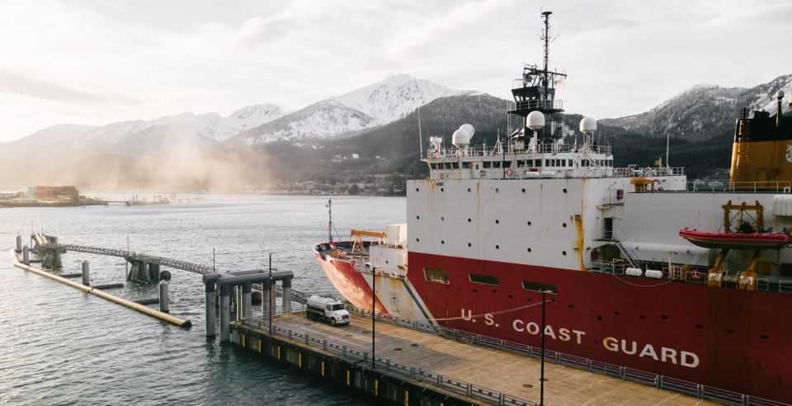
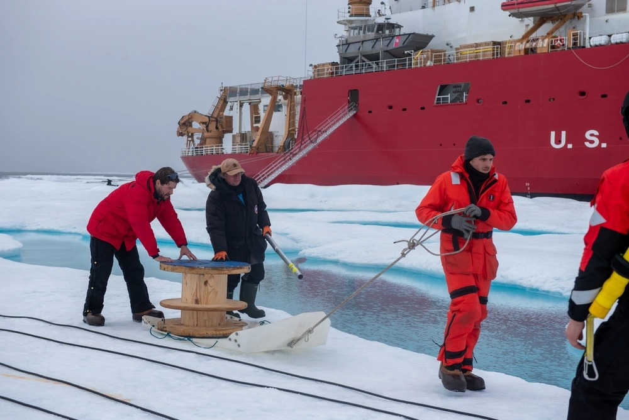
CGC Healy Planning
CGC Healy 2025 Scheme of Maneuvers being developed.
Multiple pan-Arctic routes are being considered.
Science missions in the past few years have enabled us to better/increase cooperation and partnership with the scientific community and partner nations of the Arctic Coast Guard Forum.
We hope to continue that partnership in 2025 and beyond.

Slide 3
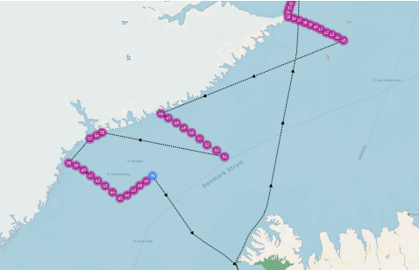
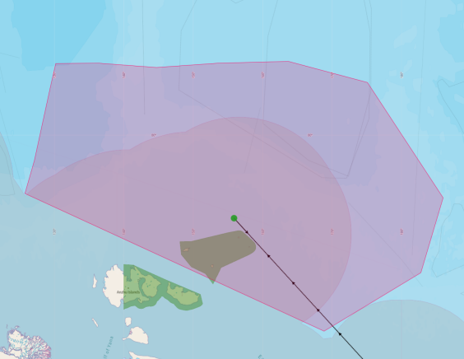
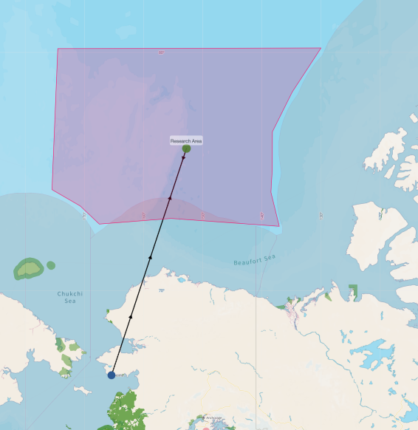
CGC Healy Planning
Primary science requests being considered for the CGC Healy 2025 Arctic deployment Scheme of Maneuver:
NABOS
AMOS
WHOI

Slide 4
CGC Healy Planning
Science missions shown do not exclude additional science of opportunity requests.
Science missions being considered alongside partner engagements both in-port and at-sea.
Final approval for CGC Healy 2025 SOM anticipated in late July/early August.
Incoming CGTF-Arctic Commander in July.

Slide 5
PACAREA Civilian Science Liaison
PACAREA & CGC Healy interviewed 6 candidates between May 28 and June 7.
Awaiting CG-1 to validate credentials and extend offer.
Position will remain Detached Duty in the Seattle area.
Position Description was updated but no significant changes expected for duties and responsibilities.
Looking forward to introducing them in person to UNOLS/AICC at the winter meeting.

Slide 6
QUESTIONS?

