Slide 1
AICC 2024 Summer Meeting
Wednesday 26 June 2024
David Allen, NOAA, GOMO/Arctic Research Program

Slide 2
SKQ2024-12S: DBO/EcoFOCI-AMBON-CEO Collaborative Ecosystem Cruise
Jackie Grebmeier¹, Seth Danielson^{2*}, Matt Galaska^{3**}, Katrin Iken² & Phyllis Stabeno³
¹University of Maryland Center for Environmental Science, ²University of Alaska Fairbanks
*=Chief Scientist, **=Co-Chief scientist
jgrebmeier@umces.edu, sldanielson@uaf.edu
DBO: Distributed Biological Observatory (Jackie Grebmeier, UMCES)
EcoFOCI: Ecosystems and Fisheries Oceanography Coordinated Investigations (Phyllis Stabeno/NOAA)
AMBON: Arctic Marine Biodiversity Observation Network (Katrin Iken, UAF)
CEO: Chukchi Ecosystem Observatory (Seth Danielson, UAF)
Contact: Seth Danielson, sdanielson@uaf.edu, Jackie Grebmeier, jgrebmei@umces.edu

Slide 3
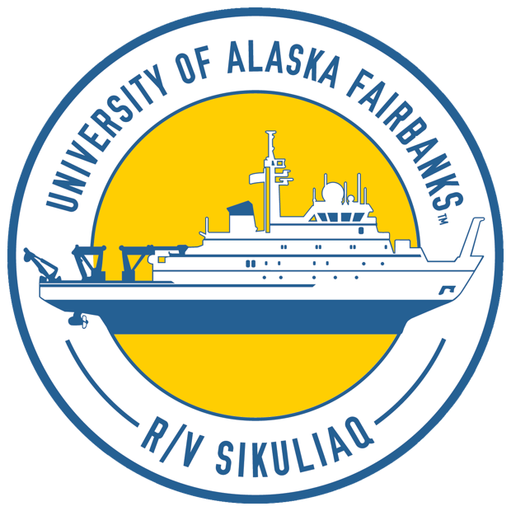
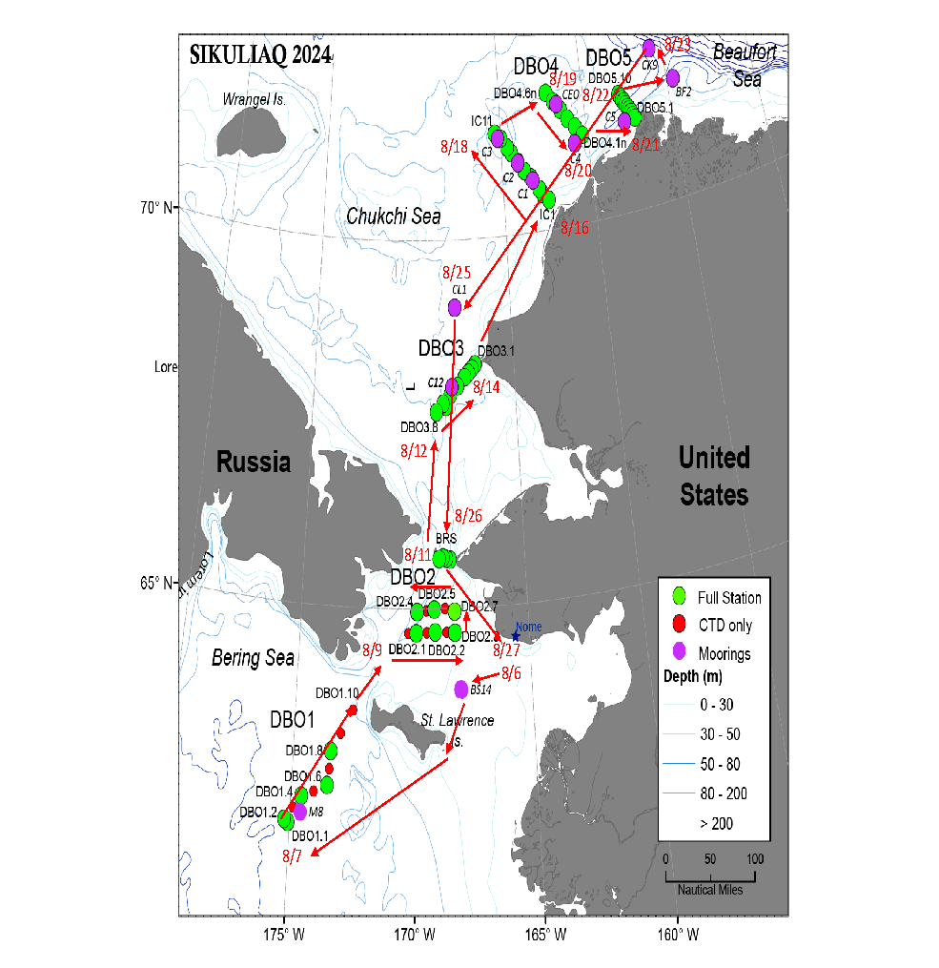
Research Expedition Details
Dates: August 6-27, 2024
Research Area Location: Northern Bering and Chukchi Seas
Vessel: R/V Sikuliaq (mob July 29 Seward, embark August 5, demob Aug 28, Nome)
Funding: Financial support provided by NOAA, ONR, AOOS, NASA, NPRB, NSF, USFWS, UAF
Communication and outreach plans:
Pre & post-cruise discussions & reporting-back with AEWC
Daily communication of activities with Alaskan coastal communities
In Nome: Planned Strait Science talk, visit local school classrooms, student tour of R/V Sikuliaq
Contact: Seth Danielson, sdanielson@uaf.edu, Jackie Grebmeier, jgrebmei@umces.edu

Slide 4
Key Scientific Questions & Motivations
Mission: To track the status and change in environmental drivers and ecosystem components undergoing change in the Pacific Arctic
Goals:
Evaluate ecosystem status, biodiversity, and change at DBO, AMBON and EcoFOCI time series stations
Deploy and recover NOAA and UAF moorings
Identify ongoing ecosystem changes in the northern Bering and Chukchi Seas
Determine conditions that cause marine animal populations to vary
Brief summary of activities:
Underway Observations: Seabird and marine mammal surveys from bridge
Water Column: CTD sampling for water temperature, salinity, bio-optical parameters, eDNA, harmful algal bloom monitoring, water samples for nutrients, water composition, Bongo net tows for zooplankton and larval fish
Seafloor: Animals in the sediment and on the bottom via grabs and trawls, sediment grain size and chlorophyll a, harmful algal bloom sampling, organic carbon and nitrogen, oxygen consumption via benthic HAPs core
Moorings: Biophysical and passive acoustic
Contact: Seth Danielson, sdanielson@uaf.edu, Jackie Grebmeier, jgrebmei@umces.edu

Slide 5
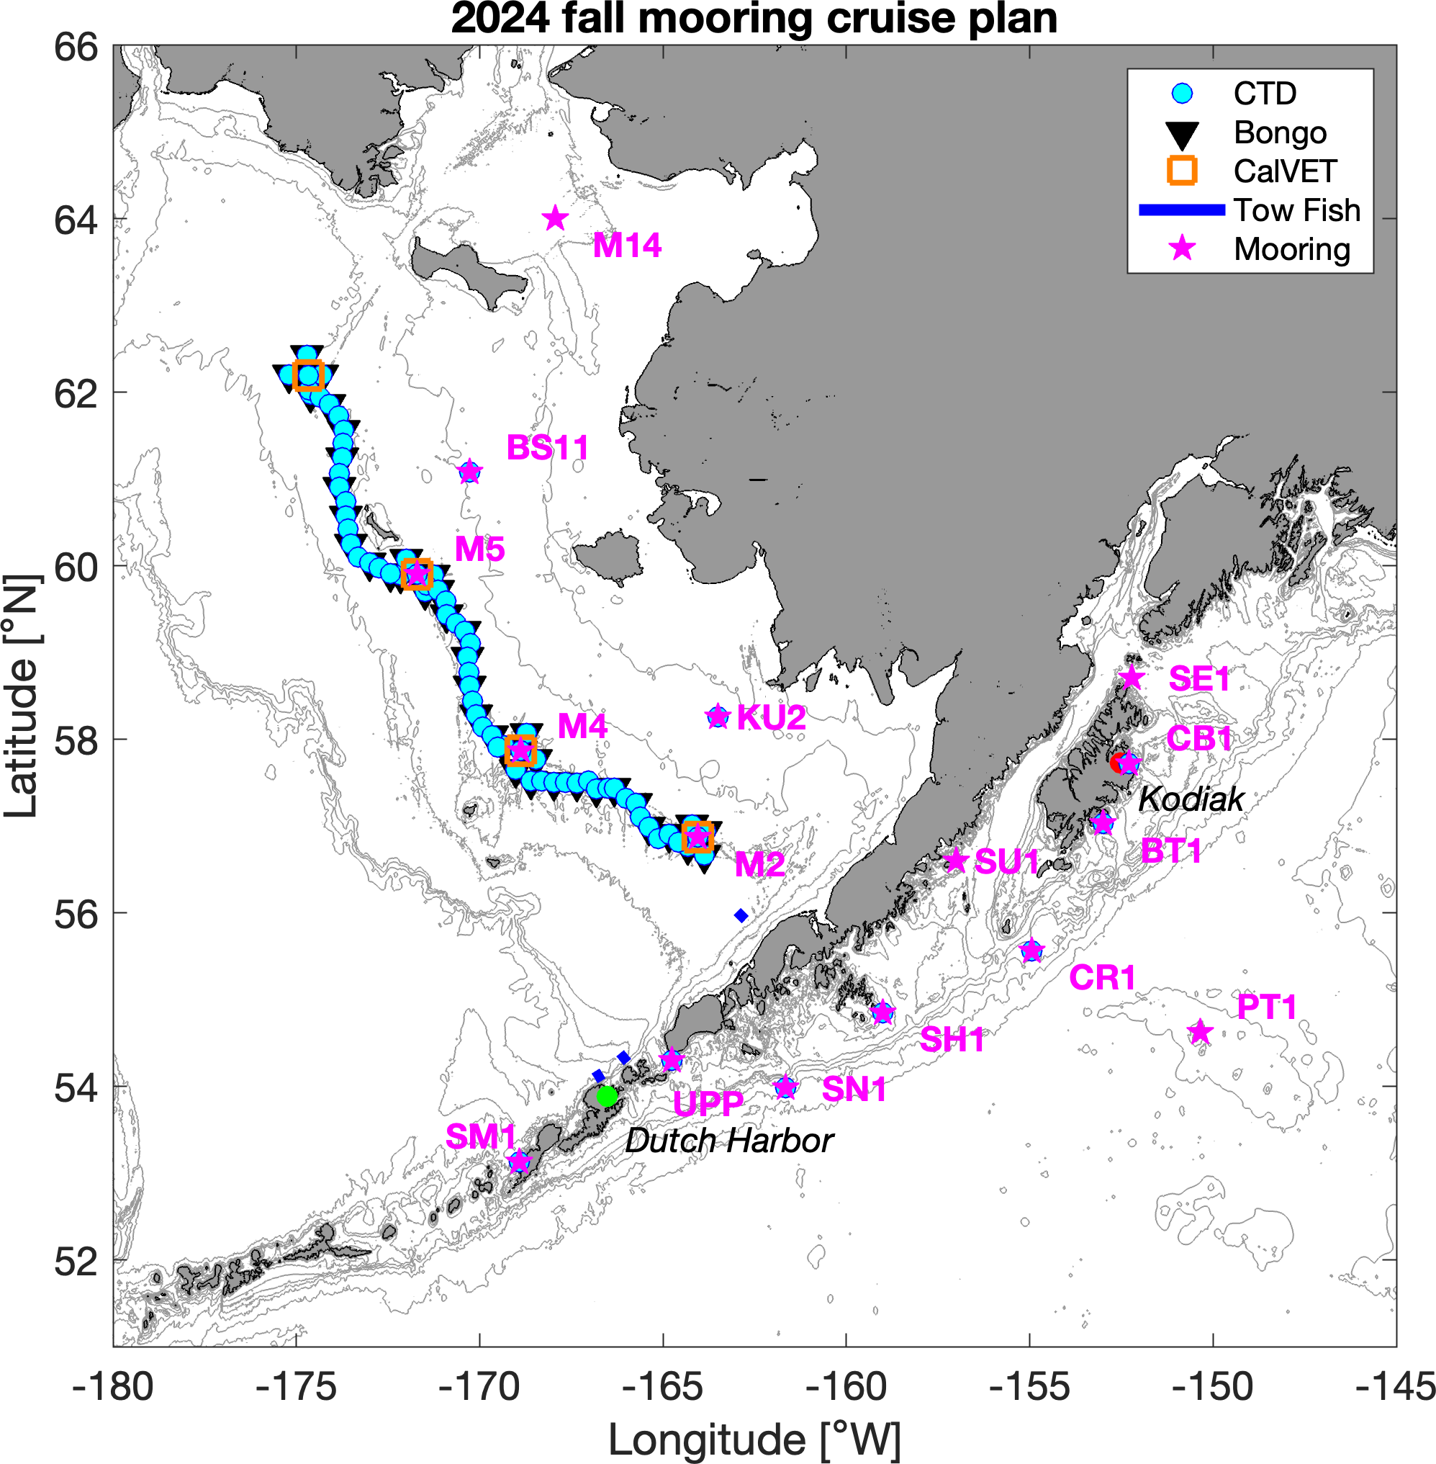
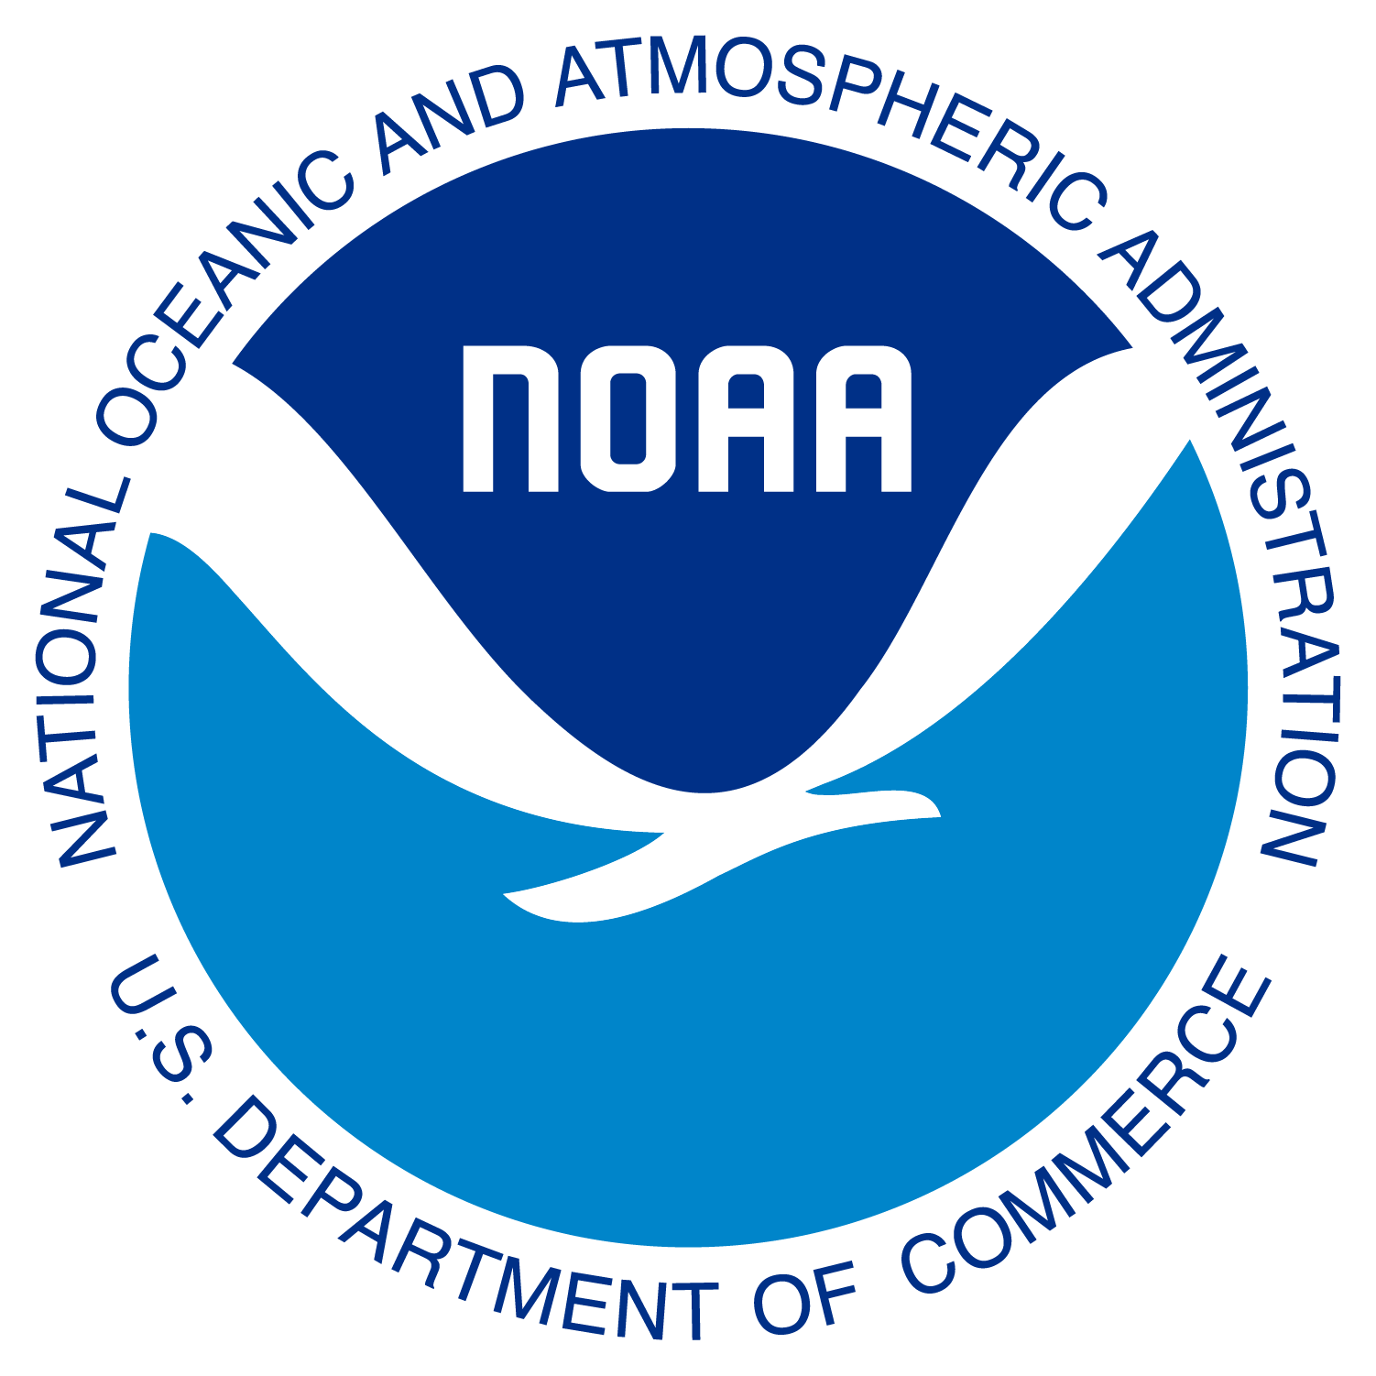
Research Expedition Details
EcoFOCI Fall Mooring Cruise
Dates: 9/7 - 9/25, 2024
Research Area Location: SE Bering Sea/ US Arctic
Vessel: NOAA Ship Oscar Dyson
Communication and outreach plans: Yes. Please contact: Primary: heather.tabisola@noaa.gov; w/ CC: theo.stein@noaa.gov, and marjorie.mooney-seus@noaa.gov
Social Media: @NOAAResearch, @NOAAFisheriesAK (IG)
Map showing the overall working area and operational sampling plan for cruise DY24-10.
Contact Information: phyllis.stabeno@noaa.gov, heather.tabisola@noaa.gov

Slide 6
Key Scientific Questions & Motivations
Mission: Annual survey to provide baseline fisheries and oceanographic data to support sustainable management of living resources in the Bering Sea and the rapidly changing US Arctic ecosystem.
Goals: Goals of the spring mooring cruise include a turn around of various NOAA biophysical (PMEL) and passive acoustic (AFSC) moorings located in the Bering Sea, perform CTD (PMEL), Bongo and CalVET (AFSC) surveys at long-term EcoFOCI sampling sites.
Brief summary of activities: (Spring) This project is intended to recover five (5) PMEL subsurface moorings and to deploy five (5) PMEL subsurface moorings and two (2) PMEL surface moorings at the Bering Sea sites of M2, M4, and KU2. In addition, four (4) marine mammal moorings (AFSC) are to be recovered and four (4) marine mammal moorings will be deployed. A hydrographic/biological survey consisting of Conductivity/Temperature/Depth (CTD) casts, 20/60 cm bongo tows and California Vertical Egg Tows (CalVETs) in the Unimak Pass area, along the 70-meter isobath in the Bering Sea as far north as the sea ice permits, and in boxes around the 4 mooring sites at M2, M4, M5, & M8. Additionally, we will deploy one (1) satellite tracked drifter. No gliders, sonobuoys, or pop-ups will be deployed this cruise. Additional projects include HABs, Flow Cytometry, eDNA and an IFCB. Fall is similar and in current planning process.
Contact Information: phyllis.stabeno@noaa.gov, heather.tabisola@noaa.gov

Slide 7
NOAA Icebreaker Requirements Working Group
The ExComm appointed David Allen (OAR/GOMO Arctic Research Program) and John (Jay) Lomnicky (OMAO/NOAA Corp Liaison to USCG) as co-leads of this working group.
The working group should regularly update the AAT and the ExComm of its progress
The working group includes representatives from all line offices
By Sept 30, 2024 (~6 months), the working group will produce a short white paper or report to the ExComm on NOAA icebreaker requirements, plus a “living document” of requirements (e.g., google doc) underpinning the report that can be routinely updated for taskers and queries.
The report and living document will be used for internal and external NOAA work, the UNOLS Arctic Icebreaker Coordinating Committee (AICC) and Congress on NOAA-USCG icebreaker needs and requirements.
This working group will be available for responding to requests and/or future actions for icebreaker requests.

Slide 8
Thank you!

