Slide 1
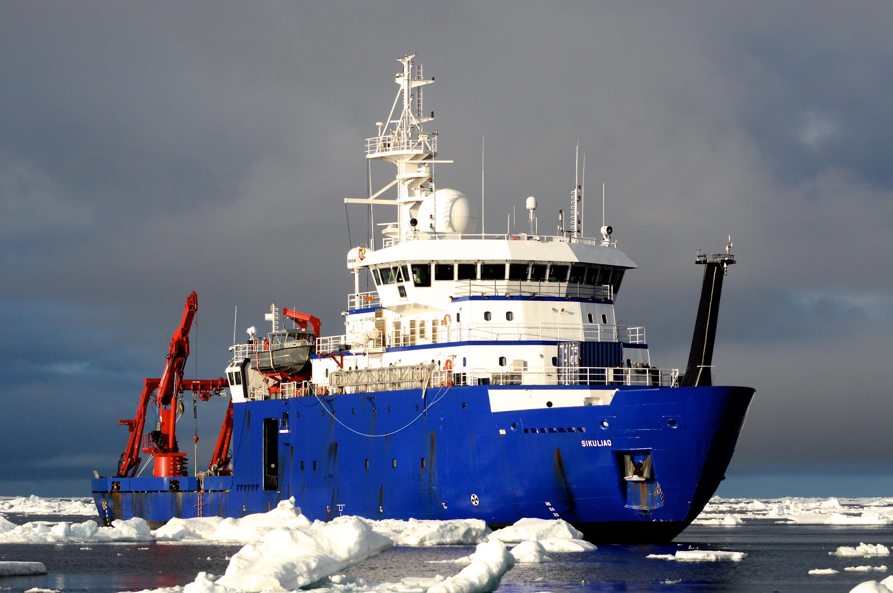
R/V Sikuliaq Operations
AICC meeting
26 June 2024
Doug Baird
Director, Seward Marine Center
CFOS, UAF
Notes:
Sikuliaq, pronounced [see-KOO-lee-auk], is an Inupiaq name meaning "young sea ice" or "young sea ice that is safe to walk on". University of Alaska "America's Arctic University" is proud to operate the R/V Sikuliaq on the behalf of the National Science Foundation (NSF).
Length, Overall (LOA) 261 feet
Beam, Max midship 48 feet
Draft, Design Waterline 18 feet 9 inches
Freeboard, Design WaterlineFDWL8 feet 9 inches
Displacement at Design Waterline 3,665 long tons
Propulsion Power 5,750 BHP
Endurance 45 days
Range (11 knots) 9,000 NM
Level Ice at 2 knots Ice thickness3 feet

Slide 2
2024 Sikuliaq Project Schedule
Spring: West Coast & Gulf of Alaska
Summer: N. Pacific Ocean, Gulf of Alaska
Late-Summer/Fall: Chukchi-Bering-Beaufort
DBO-EcoFOCI / AMBON-CEO
AMOS
Winter: Tropical Pacific Ocean
289 scheduled operational days
48 days in Arctic
Notes:
2024 started similarly to years past, with the early projects off the west coast, then moving into the Gulf of Alaska, and into the Chukchi and Beaufort Seas in late-summer; unlike recent years there are a couple of Tropical Pacific cruises to end the year.

Slide 3
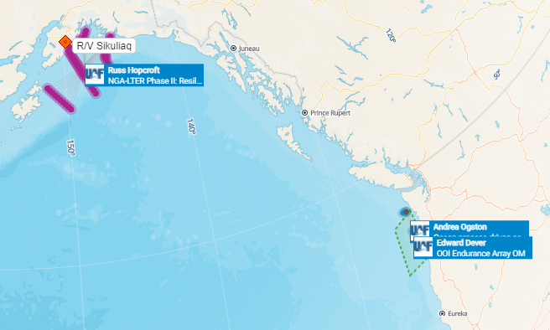
2019 Sikuliaq Project areas – Alaskan waters
Completed
Notes:
Spring 2024 was spent off the West Coast and northern Gulf of Alaska

Slide 4
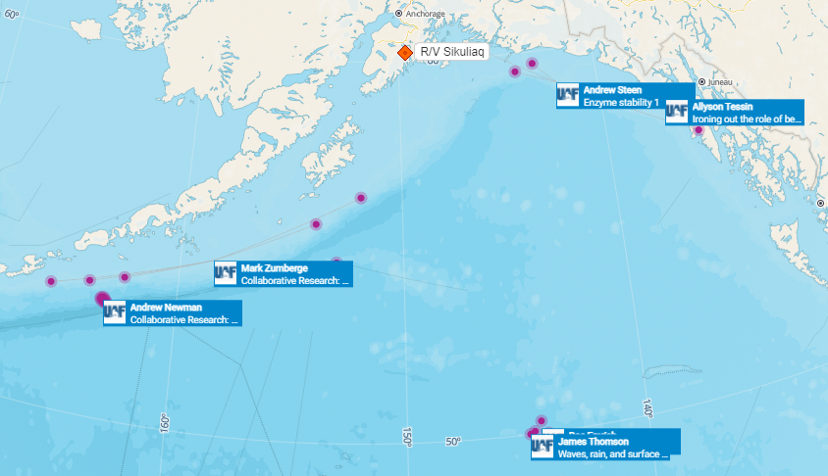
Notes:
Summer 2024 is scheduled for Gulf of Alaska and North Pacific Ocean projects

Slide 5
Notes:
Late-Summer to Fall 2024: two projects are currently scheduled in the Arctic – Jackie Grebmeier’s and Seth Danielson’s DBO-EcoFOCI and CEO-AMBON cruise; and Craig Lee’s AMOS 2024 cruise.

Slide 6
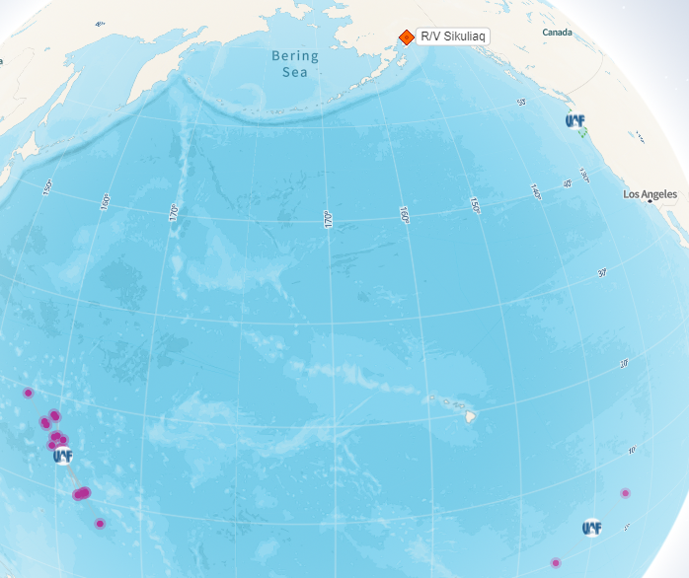
Notes:
CY2024 will end with one project off the West Coast, and two projects in the Tropical Pacific

Slide 7
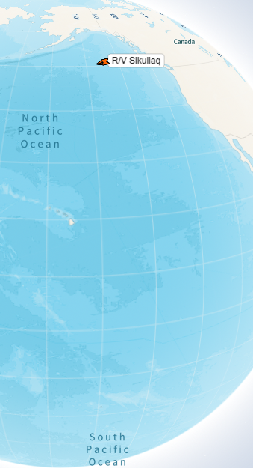
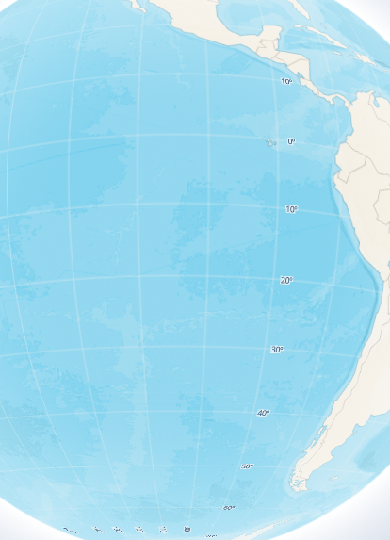
CY2025 Sikuliaq Op Area
Notes:
The tentative CY25 op area for Sikuliaq spans from the Beaufort Sea south down to southern Chile; 12 projects

Slide 8
Questions?
Notes:
Are there any questions?

