Slide 1
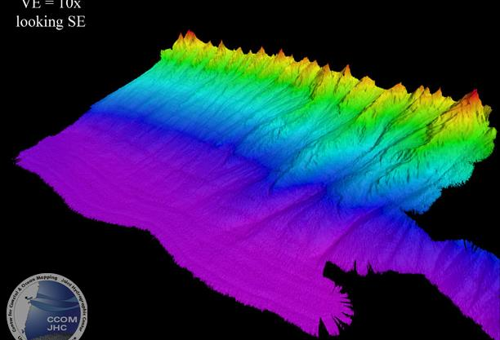
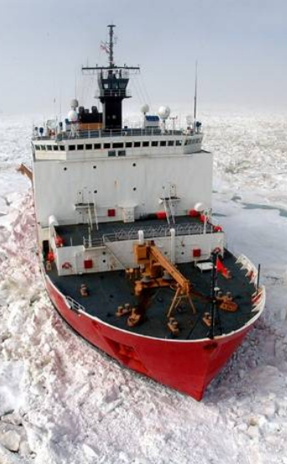
Multibeam and Sonar System Update
USCGC Healy. Credit: Mayer et al., 2016
Arctic Barrow Margin. Credit:CCOM
Alpha Ridge mapped in

Slide 2
What kind of multibeam?
Summary of AICC Input
There was support for either the Kongsberg EM124 or EM304
Addition of shallow water, high resolution mapping is desirable
Addition of EK80 Fisheries Sonar capability is desirable

Slide 3
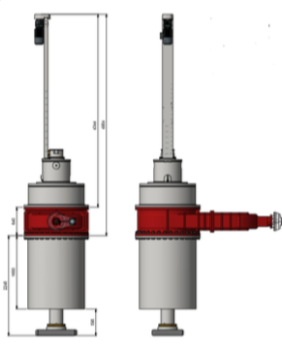
High Resolution Multibeam Option 1
Option 1: Kongsberg EM712
Should be paired with an EM124
40kHz to 100kHz system
Requires a retractable hull unit and gate valve
2 X 2 degree system
Maximum swath width: 3250m
Maximum depth: 3000m
EM712 retractable hull unit

Slide 4
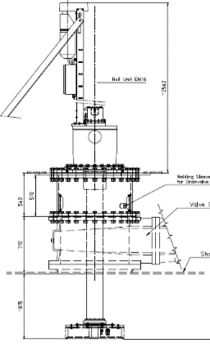
High Resolution Multibeam Option 2
Option 2: Kongsberg EM2040
Should be paired with EM304
200kHz to 700kHz system
Requires a retractable hull unit and gate valve
0.5 X 0.25 degree system
Maximum swath width: 920m
Maximum depth: 635m
EM2040 retractable hull unit

Slide 5
Decisions Points Multibeam Sonar
Upgrade the EM122 to an EM124 ice protected system paired with an EM712 system
Upgrade to the EM124 1 x 2 system during the 2022 drydock availability
Add an EM712 2 x 2 degree system, with a retractable hull unit, in 2025 drydock

Slide 6
Decisions Points Multibeam Sonar
Upgrade to an EM304 system paired with a EM2040 in 2025 –with EM122 RX replacement as a bridge to ensure quality multibeam data until 2025
Replace the existing, failing EM122 RX array in 2022 drydock
Add an EM304 0.5 x 1 degree ice- protected system in 2025 drydock
Add an EM2040 0.5 x 0.25 degree system (retractable hull unit) in 2025 drydock

Slide 7
Fisheries Sonar: EK80 18kHz and 38kHz
AICC recommendation: add EK80 fisheries sonar
18kHz and 38kHz transducers can be installed in existing wells behind ice windows
Requires the removal of acoustic release system and reference hydrophone
NB! EK80 requires target strength calibration at least annually

Slide 8
Sub-Bottom Profiler: SBP29
STARC recommendation
Remove obsolescent Knudsen 3260 Chirp 4kHz sub-bottom profiling system
Replace with Kongsberg SBP29
Narrow-beam sub-bottom profiler system with roll and pitch stabilization
System consists of a transmitter array that is paired with the receive array of a EM124 or EM304

Slide 9
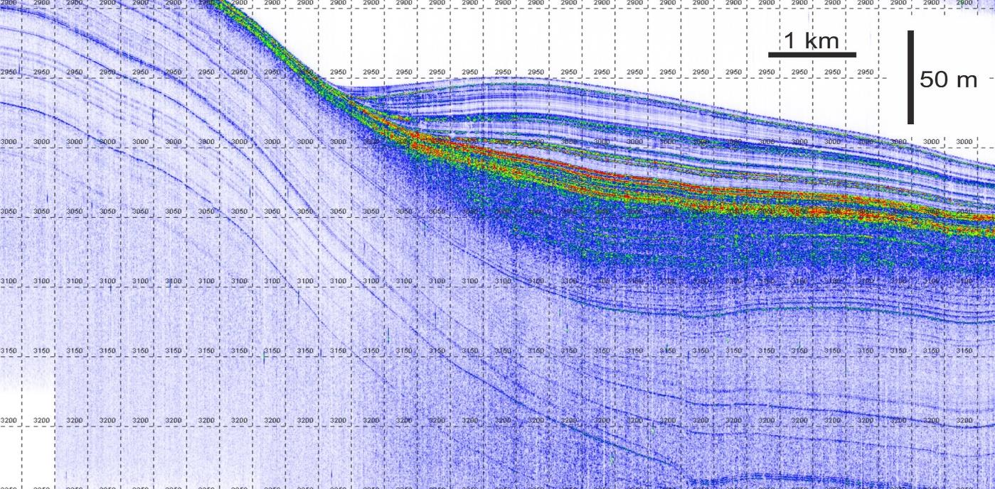
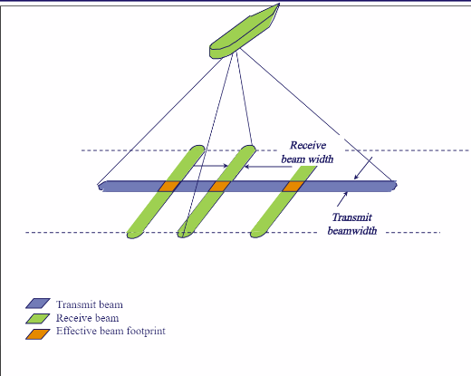
Sub-Bottom Profiler: SBP29
Data from R. Larter, British Antarctic Survey vessel RRS Darwin

Slide 10
ADCP Refurbishment
Plans are in progress to refurbish both 150kHz and 75kHz ADCP system in 2022
A system may last a decade or more but needs to be refurbished to ensure continued reliable performance

Slide 11
Reference Hydrophone Replacement
We propose to remove the reference hydrophone capability in 2022 to allow for the EK80 fisheries sonar installation.
A replacement reference hydrophone would be installed in 2025 in parallel with multibeam and/or SBP29 installation

Slide 12
Acoustic Release Modem: UTS-9400
We propose to remove the Edgetech acoustic release mooring transducer to allow for the EK80 fisheries sonar installation
To replace this capability we propose to purchase a Teledyne universal deck box that can be paired with the existing 12kHz transducer (installed in 2019)
Will be able to communicate with a broad range of instruments

Slide 13
Modification Sequence for Other Sonars
Install EK80 18kHz and 38kHz and Sea Technology Services calibration system 2022
Requires removal of the Edgetech mooring transducer
This capability could be replaced by a Teledyne UTS9000 series deck box
Requires removal of reference hydrophone
This capability would not be restored until 2025 installation of reference hydrophone system
We will also procure / install EK80 calibration system
Sea Technology Services Acoustic Calibration Unit

Slide 14
Modification Sequence for Other Sonars
Install Teledyne UTS9000 Universal Acoustic Release System (2022)
Replaces Edgetech mooring release system
Refurbish existing 75kHz and 150kHz ADCP systems in 2022

Slide 15
Modification Sequence for Other Sonars
Install a SBP29-3 or SBP29-6 sub-bottom profiler 2025 as a Knudsen sub bottom profiler replacement
3 degree or 6 degree system
The abandoned, sealed-off Sea Beam transmit array casing is in the ideal hull location for the SBP 29 TX array, and can be modified for this purpose.
EA440 or similar reference hydrophone system installation 2025

Slide 16
Multibeam and Sonar System Update
Questions?
USCGC Healy. Credit: Mayer et al., 2016

